Slide 1
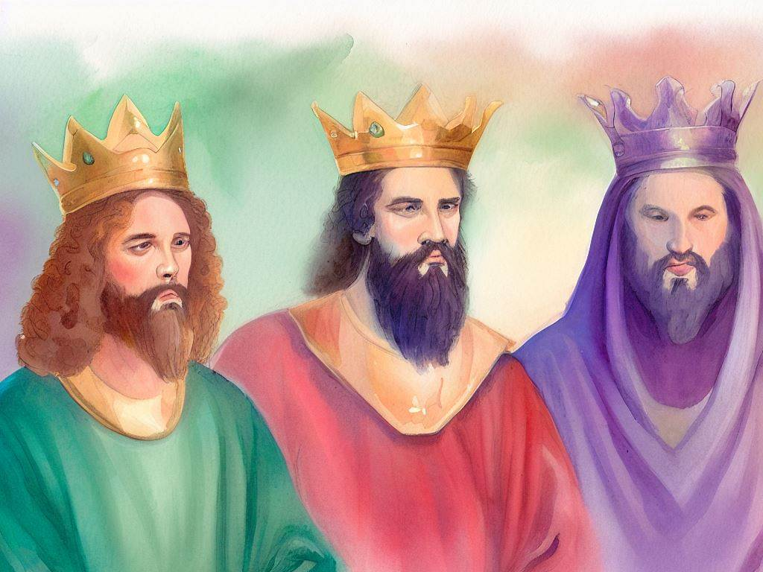
United Kingdom
Quarter 4: Lesson 17
Plans for a Temple (2 Sam. 7; 1 Chron. 17)

Slide 2
Plans for a Temple The Davidic Covenant
God’s plan for a temple is far superior to anything David had conceived!
God’s promise to David is “A milestone of Old Testament Revelation.”
Nathan’s prophecy in 2 Samuel 7:1-17 is in many ways the most important part of the books of Samuel, and one of the most important parts of the entirety of Old Testament Scripture.
Explanations and applications of the prophecy are given by later OT prophets and inspired NT writers (cf. Psalm 89:3-4).
Notes:
Psalms 89:3-4 "I have made a covenant with My chosen, I have sworn to My servant David: 4 'Your seed I will establish forever, And build up your throne to all generations.' " Selah

Slide 3
David Proposes a Temple (2 Samuel 7:1-3)
David dwelt in his comfortable house and the Lord had given him rest from all his enemies.
David expresses concern to Nathan: David’s palace in Jerusalem is built of the cedars, yet the ark dwelt in tent curtains.
Nathan responds, “Go, do all that is in your heart, for the LORD is with you.”
NOTE: Nathan’s assumption was based on faulty reasoning often used today: Since God is with me, I can do whatever is in my heart to serve/worship Him.”

Slide 4
God Vetoes David (2 Samuel 7:4-7)
The same night the word of Lord comes to Nathan and he is instructed to tell David the following:
“Would you build me a house to live in?” or “You shall not build Me a house to dwell in” 1 Chronicles 7:14).
God had not dwelt in a house but in a tent (tabernacle).
God had not asked the judges or any of the leaders of Israel to build Him a house.
SILENCE IS NOT PERMISSION!!!
Notes:
1 Chronicles 17:4 "Go and tell My servant David, 'Thus says the LORD: "You shall not build Me a house to dwell in.

Slide 5
God’s Promise to David (2 Samuel 7:8-11)
The Lord reminds David of his humble beginning, and how that He has been with him, cut off his enemies before him, and made his name great.
God will give His people a place and peace.
Like it was with the judges God promises David rest from enemies.
The Lord also promises to make a house for David.

Slide 6
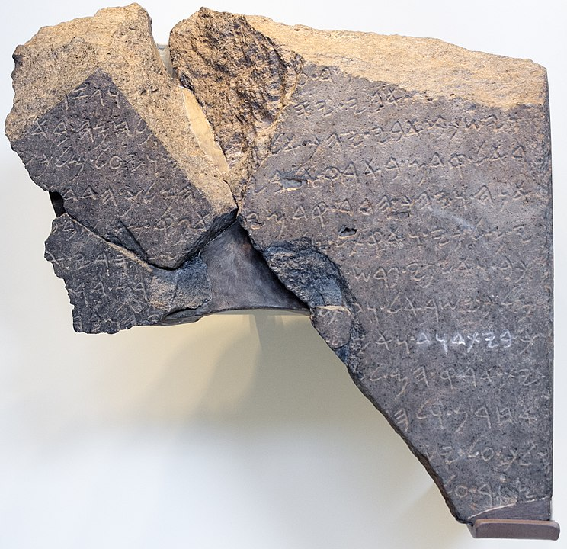
The Tel Dan Stele (9th century BC) “House of David” Inscription
The phrase “house of David” is found 25 times in the Bible from 1 Samuel 20:16 to Luke 1:27.
The Tel Dan Stele is a fragmentary stele discovered in 1993 at Tel-Dan containing an inscription which dates to the 9th century BCE. It mentions Jehoram, Ahab, and “the house of David.”

Slide 7
God’s Promise to David (2 Samuel 7:12-17)
When David’s days are fulfilled and he is gone, God promises a physical offspring.
I will establish his kingdom.
He will build a house for God’s name
God will establish the throne of his kingdom forever (cf. 1 Chron. 22:10).
God will be his Father, and he will be God’s son.
Notes:
The Lord speaking through David about Solomon--1Ch 22:10 'He shall build a house for My name, and he shall be My son, and I will be his Father; and I will establish the throne of his kingdom over Israel forever.'
Truth—Vs 12--In reference to David’s seed, the noun is collective and does not refer to Christ to the exclusion of others of David’s descendants, nor to David’s descendants exclusive of Christ, as 7:14 will show. The fulfillment of this promise most certainly includes Solomon and others, but without the ultimate fulfillment in Christ, then this promise was not fulfilled and never will be.
He shall build a house for my name, and I will establish the throne of his kingdom for ever. As we consider these verses there are several objectives we need to keep before us. One is the idea whether only Jesus is the seed of David referred to or whether the posterity of David is meant. A second objective is to note the time factor. In this verse there is a mutual arrangement: David’s seed will build God a house, and God will establish the throne of his kingdom forever. David understood that the fulfillment of God’s promise would involve David’s house for a great while to come (7:19), but David was utterly convinced that the promise was fulfilled in Solomon, and David quotes God’s words to that effect.

Slide 8
Summary of God’s Promise to David (2 Samuel 7:12-17)
God did not permit David to build Him a house.
God would build David a house!
Two-part fulfillment—
Physical
Kingdom of Solomon and descendants
Temple in Jerusalem
Spiritual
Kingdom of Christ
Temple is the church, eventually to be located in the new Jerusalem

Slide 9
The Temple Christ Built
Foretold in prophecy (Haggai 2:6-9; Zechariah 6:12-13).
Stephen declared that David wanted to build God a dwelling, but Solomon built him a house; However, “The Most High does not dwell in temples made with hands” (Acts 7:45-48).
God dwells in the bodies of Christians individually and collectively. The church is His temple! (1 Corinthians 6:19; Ephesians 2:19-20; 1 Peter 2:5).
Notes:
Haggai 2:6-9 "For thus says the LORD of hosts: 'Once more (it is a little while) I will shake heaven and earth, the sea and dry land; (7) and I will shake all nations, and they shall come to the Desire of All Nations, and I will fill this temple with glory,' says the LORD of hosts. (8) 'The silver is Mine, and the gold is Mine,' says the LORD of hosts. (9) 'The glory of this latter temple shall be greater than the former,' says the LORD of hosts. 'And in this place I will give peace,' says the LORD of hosts.“
Zechariah 6:12-13 Then speak to him, saying, 'Thus says the LORD of hosts, saying: "Behold, the Man whose name is the BRANCH! From His place He shall branch out, And He shall build the temple of the LORD; (13) Yes, He shall build the temple of the LORD. He shall bear the glory, And shall sit and rule on His throne; So He shall be a priest on His throne, And the counsel of peace shall be between them both." '
Acts 7:45-48 which our fathers, having received it in turn, also brought with Joshua into the land possessed by the Gentiles, whom God drove out before the face of our fathers until the days of David, 46 who found favor before God and asked to find a dwelling for the God of Jacob. 47 But Solomon built Him a house. 48 "However, the Most High does not dwell in temples made with hands, as the prophet says:
1 Corinthians 6:19 Or do you not know that your body is the temple of the Holy Spirit who is in you, whom you have from God, and you are not your own?
Ephesians 2:19-21 Now, therefore, you are no longer strangers and foreigners, but fellow citizens with the saints and members of the household of God, 20 having been built on the foundation of the apostles and prophets, Jesus Christ Himself being the chief cornerstone, 21 in whom the whole building, being fitted together, grows into a holy temple in the Lord,
1 Peter 2:5 you also, as living stones, are being built up a spiritual house, a holy priesthood, to offer up spiritual sacrifices acceptable to God through Jesus Christ.

Slide 10
The Throne on which Christ Reigns
The angel announces to Mary that her son, “will be called the Son of the Highest; and the Lord God will give Him the throne of His father David. And He will reign over the house of Jacob forever, and of His kingdom there will be no end” (Luke 1:31-33).
David, “knowing that God had sworn with an oath to him that of the fruit of his body, according to the flesh, He would raise up the Christ to sit on his throne, he, foreseeing this, spoke concerning the resurrection of the Christ…” (Acts 2:29-30; cf. Ps. 16).
Notes:
Luke 1:31-33 And behold, you will conceive in your womb and bring forth a Son, and shall call His name JESUS. 32 He will be great, and will be called the Son of the Highest; and the Lord God will give Him the throne of His father David. 33 And He will reign over the house of Jacob forever, and of His kingdom there will be no end.“
Acts 2:29-30 "Men and brethren, let me speak freely to you of the patriarch David, that he is both dead and buried, and his tomb is with us to this day. 30 Therefore, being a prophet, and knowing that God had sworn with an oath to him that of the fruit of his body, according to the flesh, He would raise up the Christ to sit on his throne,

Slide 11
David’s Gratitude 2 Samuel 7:18-29
David sits before the Lord to pray (7:18), and he acknowledges his own insignificance.
He perceives that God’s promise relates to his house “for a great while to come” (7:19).
He acknowledges God’s faithfulness, goodness, and unparalleled greatness (7:21-22).
God had made Israel His own people, redeemed them, and become their God (7:23-24).
David prays that God will magnify His own name by doing just as He promised for His servant David and his house (7:25-29).

Slide 12
Echoes of the Davidic Covenant in the Psalms
Psalm 89:1-4, 19-21, 29-29, 34-37
A Psalm of Ethan the Ezrahite.
Psalm 132:1-5, 10-12, 13-18
Referred to by Peter in Acts 2:30; ascribed to David.
Psalm 16:8-10
Quoted by Peter in Acts 2 and applied to Christ.
Psalm 110:1
Of this passage Jesus rhetorically asks the Pharisee, “If David then calls Him 'LORD,' how is He his Son?”
Notes:
Matthew 22:41-45 While the Pharisees were gathered together, Jesus asked them, 42 saying, "What do you think about the Christ? Whose Son is He?" They said to Him, "The Son of David." 43 He said to them, "How then does David in the Spirit call Him 'LORD,' saying: 44 'THE LORD SAID TO MY LORD, "SIT AT MY RIGHT HAND, TILL I MAKE YOUR ENEMIES YOUR FOOTSTOOL" '? 45

Slide 13
Applications for Today
We must not assume (as Nathan did) that God allows His good servants to do whatever is in their hearts.
Silence does not authorize!
Christ is sitting on the throne of David and has built the temple of the Lord.
Those who are still awaiting these things err, not knowing the Scriptures.
Abasement of self and exaltation of God are key elements in prayer.
Prayers for God to keep His promises to us and use us for His glory are especially appropriate and effective.

